Slide 1


AGNI WIGUNA
18 AUGUST 2024

Slide 2

Outline
Executive Summary
Introduction
Methodology
Results
Conclusion
Appendix

Slide 3
Executive Summary
Summary of methodologies
Collecting data using webscrapping on Wikipedia and SpaceX API
Exploratory Data Analysis (EDA) : Data wrangling and Data Visualization
Machine Learning Prediction
Summary of all results
We can get valuable information using public API and website
Using EDA we can new insight about data
Machine learning can help us to get new information and opportunity

Slide 4
Introduction
Project background and context
Space X is a large rocket launch company. SpaceX aims to conduct space tours. SpaceX has stated that it can reduce the cost of launching rockets by analyzing the first stage. If we can calculate that the first stage can land, we can calculate the cost required for the next project. From the existing public information, we will create machine learning to predict whether SpaceX can use its first stage..
Problems you want to find answers
How do we look at the variables that can determine the success of a first stage landing?
What is the best algorithm to perform this analysis?

Slide 5

Section 1

Slide 6
Methodology
Executive Summary
Data collection methodology:
Using SpaceX open API
Using web Scrapping from Wikipedia
Perform data wrangling
Filtering the data
Handling Missing Value
Apply one hot encoding for prediction preparation
Perform exploratory data analysis (EDA) using visualization and SQL

Slide 7
Data Collection
Perform interactive visual analytics using Folium and Plotly Dash
Perform predictive analysis using classification models
From the data that has been prepared, classification is carried out with various models to determine which model is most suitable.

Slide 8
Data Collection – SpaceX API
Data taken from spaceX Open API
The API will be utilized as per the flowchart on the side
Source Code : IBM-Applied-Data-Science-Capstone/Data Collection API.ipynb at main · agniwii/IBM-Applied-Data-Science-Capstone (github.com)
Api Call
Filtering Data
Handle Missing Value

Slide 9
Data Collection - Scraping
SpaceX rocket launch data can also be obtained from wikipedia
Data is taken by scraping using BS4 and retrieved related tables
Source Code : IBM-Applied-Data-Science-Capstone/Data Collection with Web Scrapping.ipynb at main · agniwii/IBM-Applied-Data-Science-Capstone (github.com)
Request the data
Get Related tables
Save the data

Slide 10
Data Wrangling
In the data set, there are several different cases where the booster did not land successfully. Sometimes a landing was attempted but failed due to an accident; for example, True Ocean means the mission outcome was successfully landed to a specific region of the ocean while False Ocean means the mission outcome was unsuccessfully landed to a specific region of the ocean. True RTLS means the mission outcome was successfully landed to a ground pad False RTLS means the mission outcome was unsuccessfully landed to a ground pad.True ASDS means the mission outcome was successfully landed on a drone ship False ASDS means the mission outcome was unsuccessfully landed on a drone ship.
In this lab we will mainly convert those outcomes into Training Labels with `1` means the booster successfully landed `0` means it was unsuccessful.
Source Code : IBM-Applied-Data-Science-Capstone/Data Wranggling.ipynb at main · agniwii/IBM-Applied-Data-Science-Capstone (github.com)
EDA
Get new insight
Create landing outcome label

Slide 11
EDA with Data Visualization
Charts were plotted:
Flight Number vs. Payload Mass, Flight Number vs. Launch Site, Payload Mass vs. Launch Site, Orbit Type vs. Success Rate, Flight Number vs. Orbit Type, Payload Mass vs Orbit Type and Success Rate Yearly Tren.
Scatter plots show the relationship between variables.
Bar charts show comparisons among discrete categories.
Line charts show trends in data over time (time series)
Source Code : IBM-Applied-Data-Science-Capstone/Eda Data Visualization.ipynb at main · agniwii/IBM-Applied-Data-Science-Capstone (github.com)

Slide 12
EDA with SQL
Performed SQL Query:
Names of the unique launch sites in the space mission;
Top 5 launch sites whose name begin with the string 'CCA’;
Total payload mass carried by boosters launched by NASA (CRS);
Average payload mass carried by booster version F9 v1.1;
Date when the first successful landing outcome in ground pad was achieved;
Names of the boosters which have success in drone ship and have payload mass between 4000 and 6000 kg;
Total number of successful and failure mission outcomes;
Names of the booster versions which have carried the maximum payload mass;
Failed landing outcomes in drone ship, their booster versions, and launch site names for in year 2015;
Rank of the count of landing outcomes (such as Failure (drone ship) or Success (ground pad)) between the date 2010-06-04 and 2017-03-20.
Source Code : IBM-Applied-Data-Science-Capstone/EDA with SQL.ipynb at main · agniwii/IBM-Applied-Data-Science-Capstone (github.com)

Slide 13
Build an Interactive Map with Folium
Markers of all Launch Sites:
Added Marker with Circle, Popup Label and Text Label of NASA Johnson Space Center using its latitude and longitude coordinates as a start location.
Added Markers with Circle, Popup Label and Text Label of all Launch Sites using their latitude and longitude coordinates to show their geographical locations and proximity to Equator and coasts.
Coloured Markers of the launch outcomes for each Launch Site:
Added coloured Markers of success (Green) and failed (Red) launches using Marker Cluster to identify which launch sites have relatively high success rates.
Distances between a Launch Site to its proximities:
Added coloured Lines to show distances between the Launch Site KSC LC-39A (as an example) and its proximities like Railway, Highway, Coastline and Closest City
Source Code : IBM-Applied-Data-Science-Capstone/Visual Analytics with Folium.ipynb at main · agniwii/IBM-Applied-Data-Science-Capstone (github.com)

Slide 14
Build a Dashboard with Plotly Dash
Launch Sites Dropdown List
Added a dropdown list to enable Launch Site selection.
Pie Chart showing Success Launches (All Sites/Certain Site)
Added a pie chart to show the total successful launches count for all sites and the Success vs. Failed counts for the site, if a specific Launch Site was selected
Slider of Payload Mass Range
Added a slider to select Payload range
Scatter Chart of Payload Mass vs. Success Rate for the different Booster Versions:
Added a scatter chart to show the correlation between Payload and Launch Success
Source Code : IBM-Applied-Data-Science-Capstone/spacex_dash_app.py at main · agniwii/IBM-Applied-Data-Science-Capstone (github.com)

Slide 15
Predictive Analysis (Classification)
The steps I applied from start to finish were data extraction, data transformation, data sharing, finding the best parameters, model evaluation, and finding the best model.
Extract Data
Split Data into train test Set
Create Grid search in every model to find best parameter
Find the best Method from all the models
Examine the confusion matrix
Calculated every Accuracy that shown by model
Source Code : IBM-Applied-Data-Science-Capstone/Predictive Analyze.ipynb at main · agniwii/IBM-Applied-Data-Science-Capstone (github.com)

Slide 16
Results
Exploratory data analysis results
Interactive analytics demo in screenshots
Predictive analysis results

Slide 17

Section 2

Slide 18
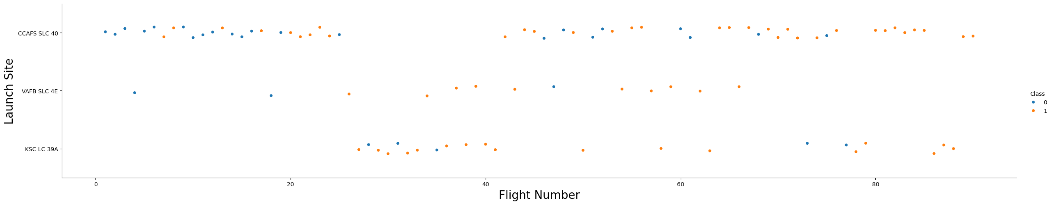
Flight Number vs. Launch Site
A scatter plot of Flight Number vs. Launch Site
Explanations
There are some gaps in the flight number sequence, particularly noticeable for VAFB SLC-4E and KSC LC-39A.
CCAFS SLC-40 is the most frequently used launch site, with points clustered densely at the top of the chart.
Most of the earliest flight are not success
Lastest flight have more successfull rate

Slide 19
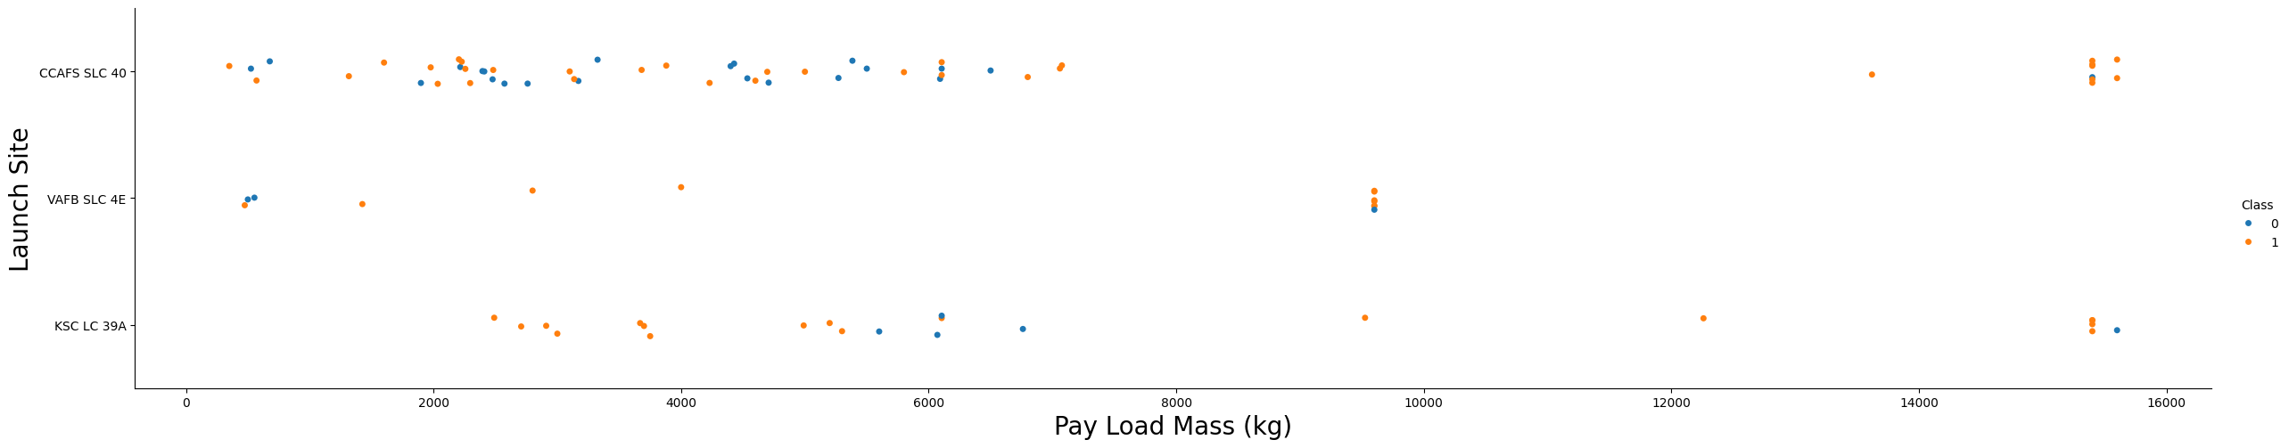
Payload vs. Launch Site
A scatter plot of Payload vs. Launch Site
Explanations
Now if you observe Payload Vs. Launch Site scatter point chart you will find for the VAFB-SLC launchsite there are no rockets launched for heavypayload mass(greater than 10000).

Slide 20
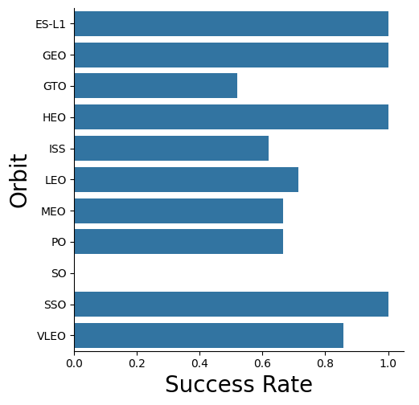
Success Rate vs. Orbit Type
A bar chart for the success rate of each orbit type
Explanation
1. ES-L1, GEO, HEO, and SSO have the highest success rates, both at or very close to 100%.
2. VLEO has a success rate of about 85-90%.
3. LEO , ISS , MEO, and PO all have success rates between 70-80%.
4. GTO has the lowest success rate among the orbits shown, at around 50-60%.

Slide 21
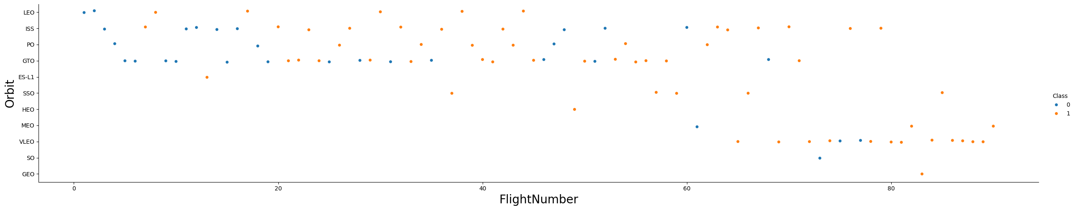
Flight Number vs. Orbit Type
A scatter point of Flight number vs. Orbit type
Explanations
You should see that in the LEO orbit the Success appears related to the number of flights
on the other hand, there seems to be no relationship between flight number when in GTO orbit.

Slide 22
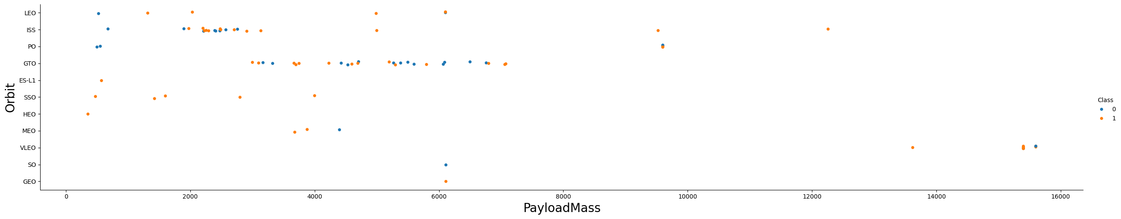
Payload vs. Orbit Type
Show a scatter point of payload vs. orbit type
Explanations
With heavy payloads the successful landing or positive landing rate are more for Polar,LEO and ISS.
However for GTO we cannot distinguish this well as both positive landing rate and negative landing(unsuccessful mission) are both there here.

Slide 23
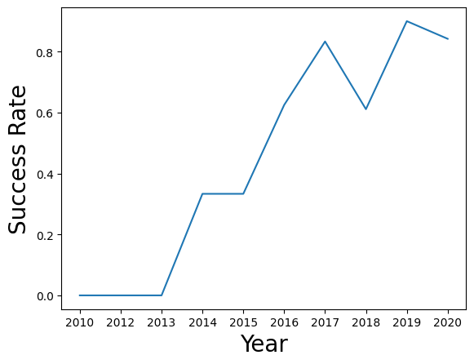
Launch Success Yearly Trend
Aline chart of yearly average success rate
Explanations
You can observe that the success rate since 2013 kept increasing till 2017 (stable in 2014) and after 2015 it started increasing.

Slide 24
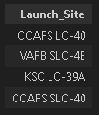
All Launch Site Names
Find the names of the unique launch sites
It retrieved all unique launch site using distinct function

Slide 25
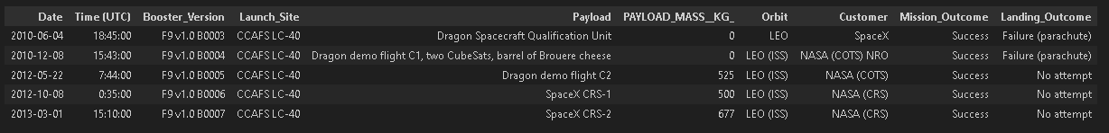
Launch Site Names Begin with 'CCA'
Find 5 records where launch sites begin with `CCA`
Retrieve only 5 record that launchsite begin with CCA using like and limit method

Slide 26
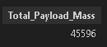
Total Payload Mass
Calculate the total payload carried by boosters from NASA
Sum all total payload mass on the table

Slide 27
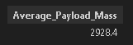
Average Payload Mass by F9 v1.1
Calculate the average payload mass carried by booster version F9 v1.1
Calculate all average data if booster version F9 v1.1

Slide 28

First Successful Ground Landing Date
Find the dates of the first successful landing outcome on ground pad
Get minimum date when landing outcome on ground pad

Slide 29
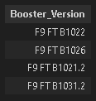
Successful Drone Ship Landing with Payload between 4000 and 6000
List the names of boosters which have successfully landed on drone ship and had payload mass greater than 4000 but less than 6000
Include all booster_version when they had payload mass greater than 4000 but less than 6000

Slide 30
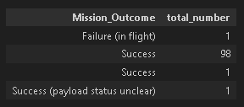
Total Number of Successful and Failure Mission Outcomes
Calculate the total number of successful and failure mission outcomes
Count every mision outcome that have been grouping before

Slide 31
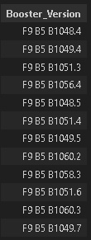
Boosters Carried Maximum Payload
List the names of the booster which have carried the maximum payload mass
Select all booster version when it has same maximum mass

Slide 32
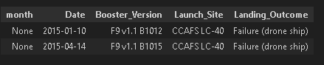
2015 Launch Records
List the failed landing_outcomes in drone ship, their booster versions, and launch site names for in year 2015
Shown landing outcome that failure in 2015

Slide 33
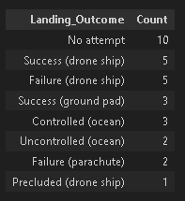
Rank Landing Outcomes Between 2010-06-04 and 2017-03-20
Rank the count of landing outcomes (such as Failure (drone ship) or Success (ground pad)) between the date 2010-06-04 and 2017-03-20, in descending order
This view of data alerts us that “No attempt” must be taken in account

Slide 34

Section 3

Slide 35
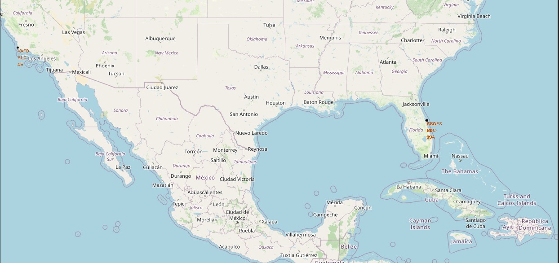
All Launch Site
Those Launch site located near sea

Slide 36
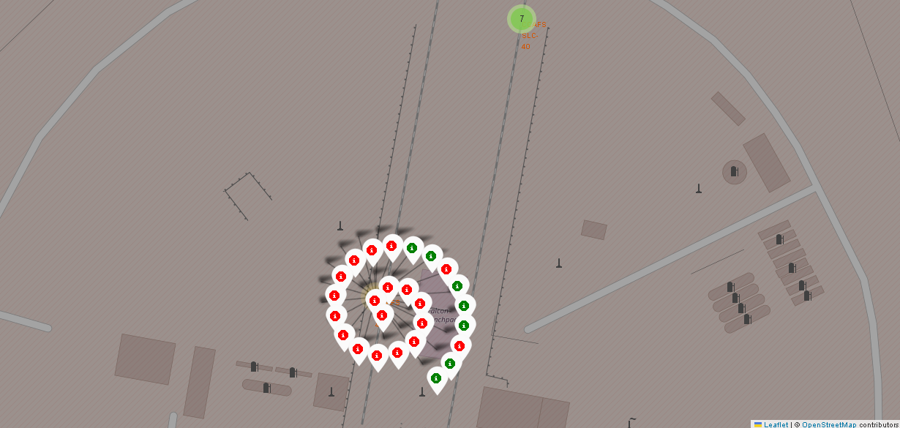
Success and Failure Launch
Add marker color to see the spread data in map

Slide 37
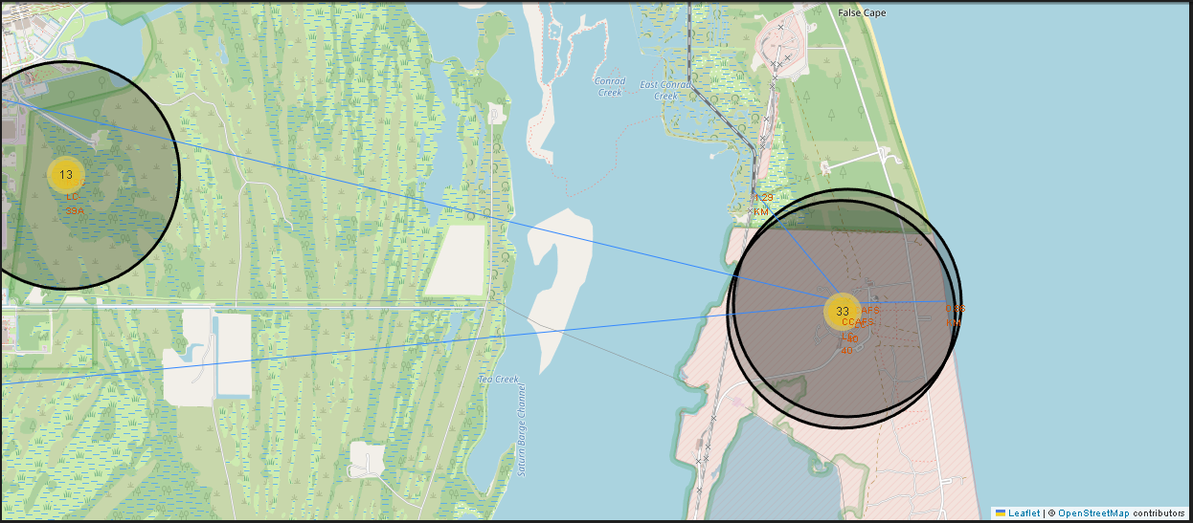
Distance to Railway and the other
Using harvenstein distance to calculate distance in spherical object

Slide 38

Section 4

Slide 39
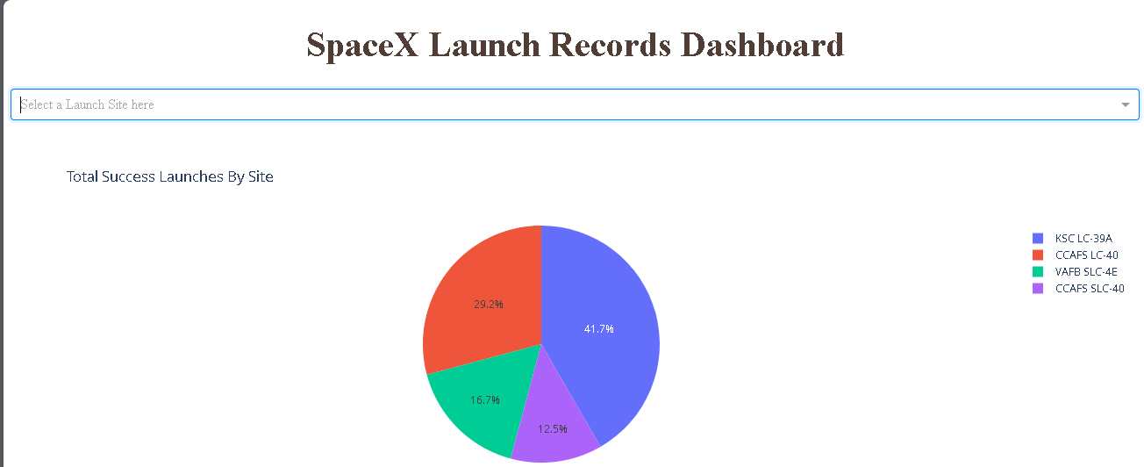
Successfull Launch by launch site
Its important to know launch success distributed

Slide 40
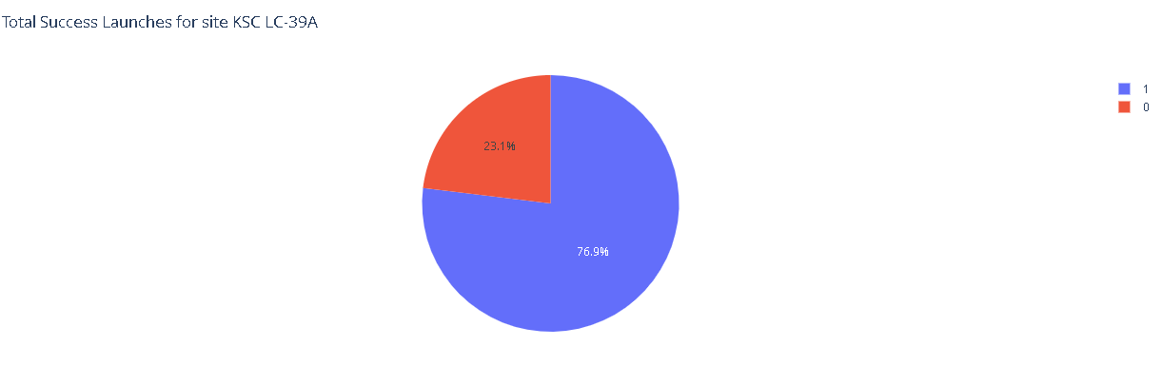
Highest Launch Ratio
KSC LC-39 A has highest launch rasio : 76.9%

Slide 41
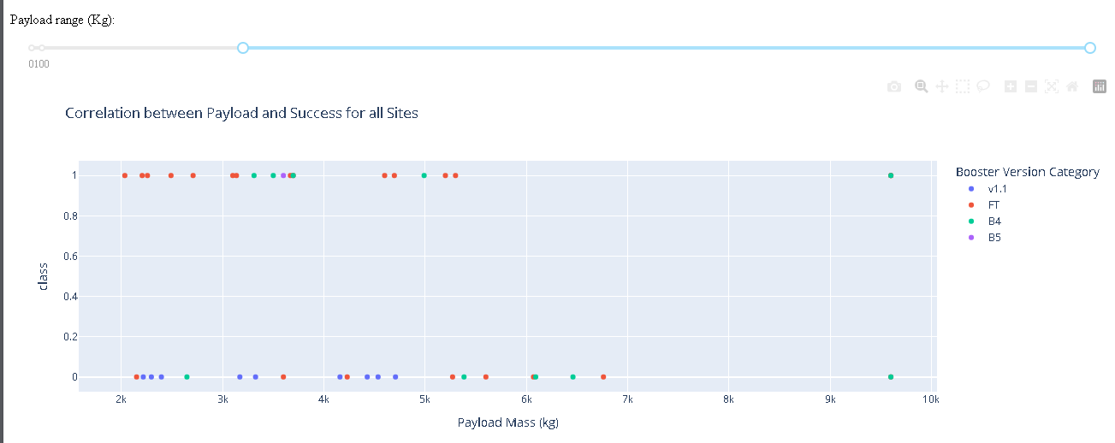
Payload vs. Launch Outcome
Payloads under 6,000kg and FT boosters are the most successful combination.

Slide 42

Section 5

Slide 43
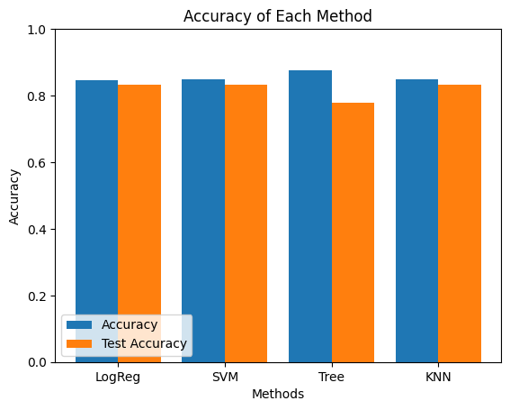
Classification Accuracy
The model with the highest classification accuracy is Decision Tree Classifier, which has accuracies over than 87%

Slide 44
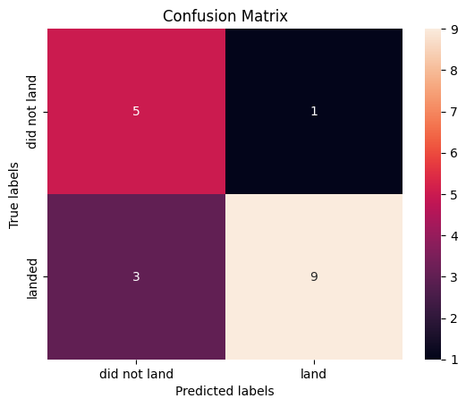
Confusion Matrix
Confusion matrix of Decision Tree Classifier proves its accuracy by showing the big numbers of true positive and true negative compared to the false ones.

Slide 45
Conclusions
Different data sources were analyzed, refining conclusions along the process;
The best launch site is KSC LC-39A
Launches above 7,000kg are less risky
Although most of mission outcomes are successful, successful landing outcomes seem to improve over time, according the evolution of processes and rockets
Set Parameter on model is key to obtain best result and decision tree have the best result over the other model

Slide 46
Appendix
Some of code need to explore by ourshelf

Slide 47


